Slide 1

Project Proposal: Workforce Analysis and Visualization
FA 550: Data Visualization Application
By,
Aston Glen Noronha

Slide 2
INDEX
Research Questions
Introduction
Project Schedule
Data
Visualization

Slide 3

INTRODUCTION
This project delves into a workforce dataset, examining education, tenure, geography, payment tiers, age, gender, and leave patterns. The dataset’s complexity aligns with contemporary workforce dynamics, offering insights crucial for HR analytics.

Slide 4



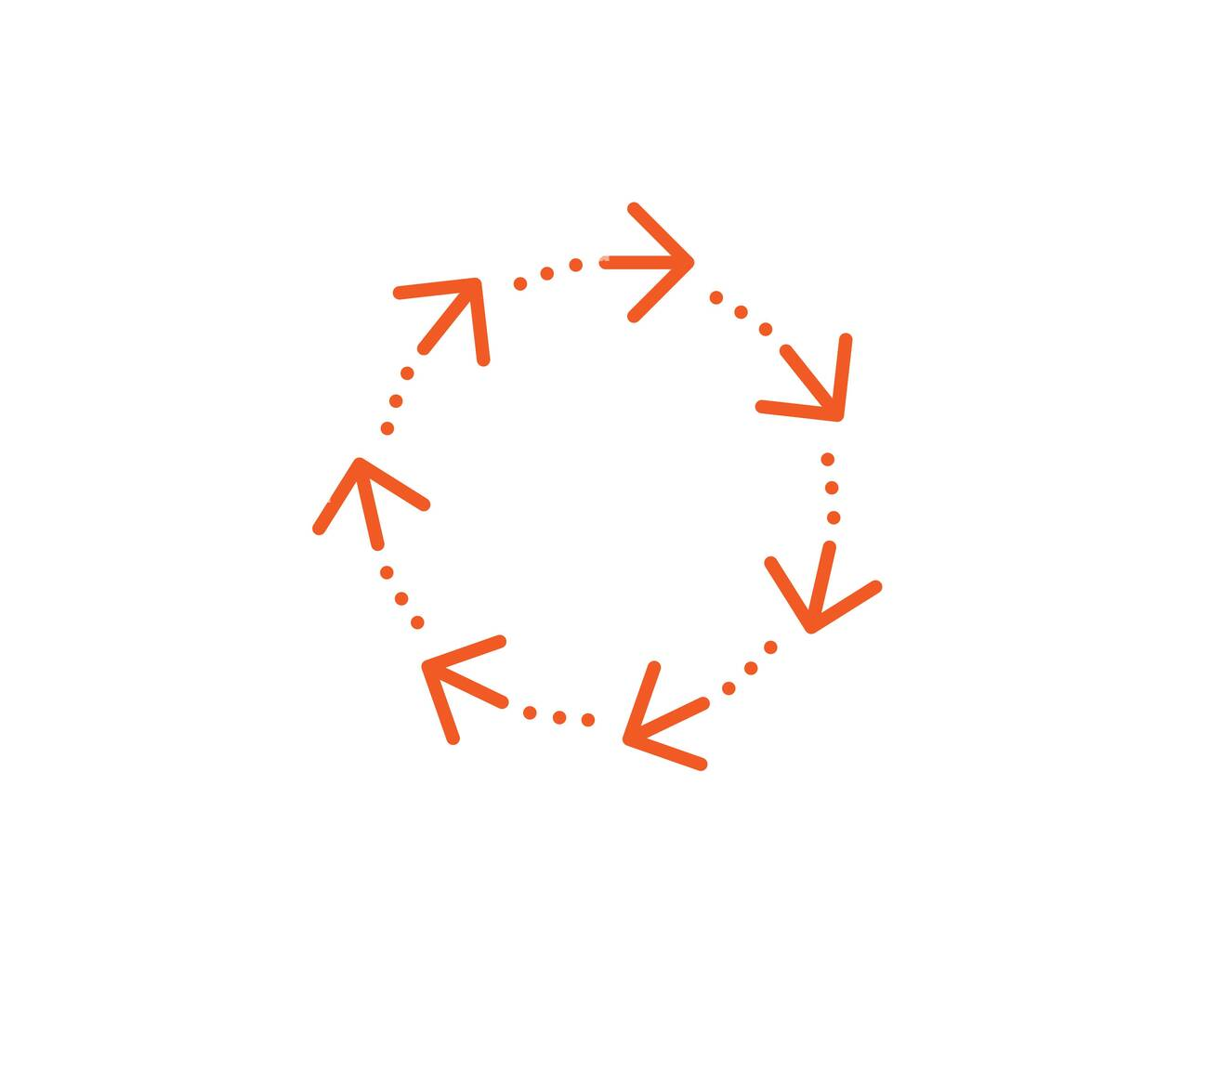
PRIMARY RESEARCH QUESTIONS
What are the workforce patterns across different cities?
What is the gender breakdown, and are there specific gender-related turnover patterns?
How does education vary across payment tiers?
Is there a correlation between Payment Tier and Experience?

Slide 5
PROJECT SCHEDULE
10th April | Detailed proposal ready for submission, inclusive of research questions and dataset description
17th April | Dataset identified and initial cleaning completed using Tableau Prep.
24th April | Visualizations and draft narrative addressing research questions complete
1st March | Draft narrative addressing research questions complete; Begin working on presentation
8th March | Finalize the draft presentation for review, ensuring it is complete and ready for evaluation, make final adjustments and identify specific points that may have further exploration.

Slide 6
DATA
The dataset is from Kaggle (https://www.kaggle.com/datasets/tawfikelmetwally/employee-dataset?resource=download).
The dataset captures diverse workforce attributes, including educational qualifications, joining years, city-wise distribution, payment tiers, age demographics, gender diversity, and leave patterns. Collected from a company's HR department, this anonymized dataset is a valuable resource for HR analytics and organizational insights.
I am particularly interested in leveraging education, gender, city, and experience against employee attrition.

Slide 7
VISUALIZATIONS
Tree Maps
To analyze the distribution of the workforce across cities
Side-by-Side Bar Chart
To analyze attrition patterns across education
Line Graph
Area Chart
Stacked Bar Chart
To analyze employee growth over time
To analyze attrition patterns across age
To analyze the gender distribution among the workforce
Packed Bubbles Chart
Would be used to analyze the educational landscape between the employees

Slide 8
Thank You!
- Aston Glen Noronha

